Slide 1
SBOM Visualization and Exploration Toolkit
Thomas Eby, Pranav Gonepalli, Manel Leong,
Camron Rule, Skyler Walker, Duohan Xu, Rachel Zheng
College of William & Mary
CSCI 435: Software Engineering
December 4, 2024

Slide 2
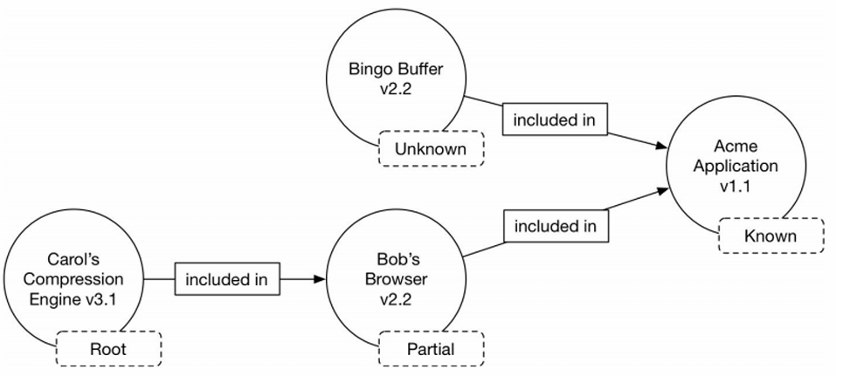
What is an SBOM?
Software Bill of Materials (SBOM) = A formal document that is machine-readable and describes the components that make up a software product, their relationships, and their dependencies.

Slide 3
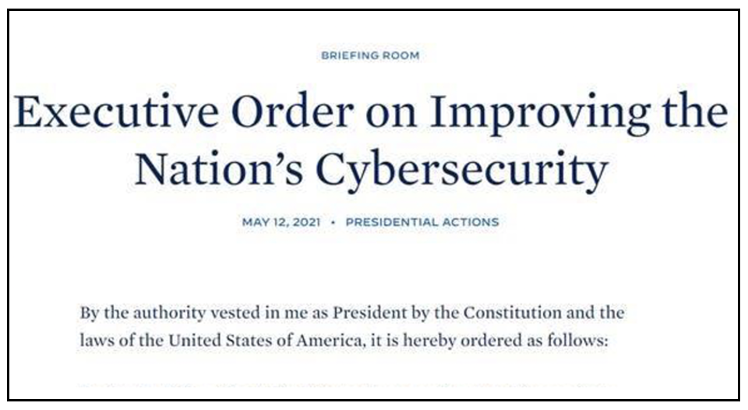
Relevance of SBOMs
Executive Order 14028 (5/2021) for Cybersecurity
Requires all federal contractors to share threats, vulnerabilities, and cyber incidents to the federal government.
Requires the creation of SBOMs

Slide 4
Relevance of SBOMs
Implications: SBOM popularity will increase for private sector to comply with federal regulations.
License and vulnerability information
Dependency hierarchy

Slide 5
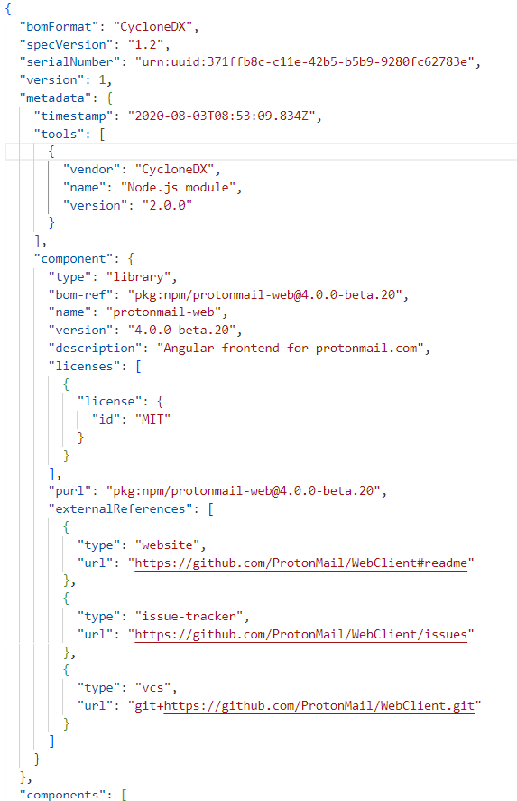
Motivation
Difficulties with SBOMs:
Difficult for humans to read
Important information must be extracted and visualized
SBOM generation tools exist, but few tools for visualization exist

Slide 6
Solution
Open-source, Django-based web application that extracts and visualizes the most important information in an SBOM:
Software dependency tree
License distribution
Top vulnerability identification and vulnerability distribution

Slide 7
Overview of Accomplishments
Parsing
SPDX 2.2, 2.3, 3.0
CycloneDX
Tree Visualization
Analysis
Licenses
Vulnerabilities

Slide 8
Demo

Slide 9
Testing and Validation
Mostly manual testing
We have a set of ~15 SBOMs that we used to test
These were taken from public GitHub repos
Security Testing
Wrote one test class based on a specific SBOM file
Sanity check whenever code was modified

Slide 10
Limitations and Improvements
More in depth license analysis
Representation of more info from CycloneDX sboms
Additional pages only visible when processing a CycloneDX file
Security analysis may not work on some SBOMs and the quantity/quality of information shown is highly dependent on the SBOM
Notes:
There is another form of relationships in CycloneDX called component composition which is different from dependency relationships which would be useful to show separately.

Slide 11
Lessons from Project
There are many factors to consider when incorporating 3rd party software/ packages (eg. installation, compatibility, updated versions)
Consistent communication is crucial to ensure that interfaces between different components (e.g., frontend and backend) work as expected and that teams are on the same page.
Unexpected preconditions or requirements may come up during the software process that require creativity to solve and redesign, which is one instance where agile is most useful (e.g., SBOMs being stored as graphs rather than trees).

Slide 12
Contributions
Skyler:
Coordinated and organized project meetings.
Debugged tree visualization and implemented license processing and display.
Created the PDF preview and set up page transitions.
Camron:
Wrote documentation
Set up and helped to improve initial tree visualization
Created frontend elements on license and security pages
Pranav:
Front-end work and design
Special focus on the component info sidebar and relationships
Bug fixes and quality of life changes

Slide 13
Contributions
Manel:
Created Tree Builder
Created Relationship Map Builder
Created SPDX 2 xml parsers
Aided in backend refactoring and planning
Thomas:
Created initial tree-building algorithm
Created SPDX 2 json parser
Created CycloneDX json and xml parsers
Rachel:
Security and license analysis of SBOM’s
Duohan:
Created SPDX 3 json and xml parsers

Slide 14
References
“Improving the nation’s cybersecurity,” Federal Register, May 17, 2021. https://www.federalregister.gov/documents/2021/05/17/2021-10460/improving-the-nations-cybersecurity

